Slide 1
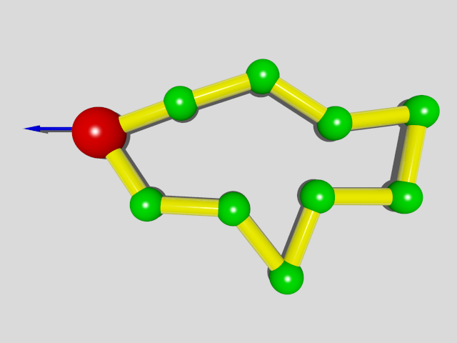
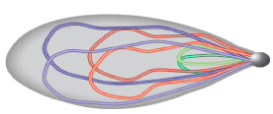
Problem
Toy model with 100 beads
Real System
Solution:
Parallel computation

Slide 2
Ways to go
Use some kinds of sophisticated MD packages
Advantage:
easier to go, parallelize automatically
Disadvantage:
cannot control some details, e.g. random force
not so flexible
Write a parallel program
Totally under control but need more time on technique details
My Strategy
Doesn’t work
Write a parallel program
Try MD packages

Slide 3
List of MD packages
http://en.wikipedia.org/wiki/List_of_software_for_molecular_mechanics_modeling
Rules of selection
No commercial, should be free
Need GPU acceleration
Widely used
Selected packages:
Gromacs
LAMMPS
ESPResSo

Slide 4
Dynamics of Chromosome Movements During Meiosis in Fission Yeast
--- bead-rod ring model
Yen Ting Lin, Wenwen Huang, Daniela Frömbery, Vasily Zaburdaev
08.09.2014
For PhD seminar

Slide 5
Outline
Reminder
1 D lattice model
3 D model and simulation comparison
A pair of chromosomes with centromere
Outlook and Problems

Slide 6
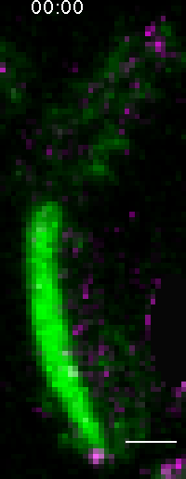
Chromosome Movement ( S. pombe)
3 pairs of chromosomes
Telomere bond to SPB
Oscillation is driven by SPB
In the mean time:
Homologous chromosomes
paring and recombination
Chikashige et al., Science 1994
Yamamoto et al, JCB 1999
Ding et al., DevCell 2004

Slide 7
Bead-Rod Ring Model
A Chromosome is represented by a bead-rod ring with
the driven bead be the SPB(spindle pole body).
Ring driven by a Constant force
Bead:
position ----
Rod:
length ---

Slide 8
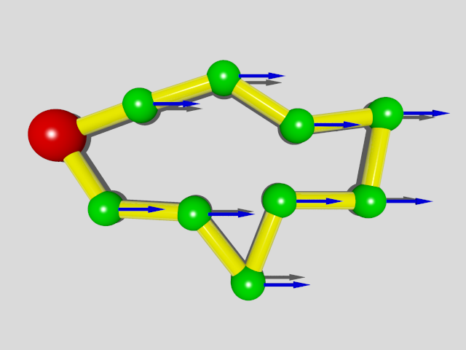
Theory for 1D model
Transfer to co-moving frame:
Constant driven force on SPB
Constant force field and pinned SPB
For 1D system:
Loop Constraint:

Slide 9
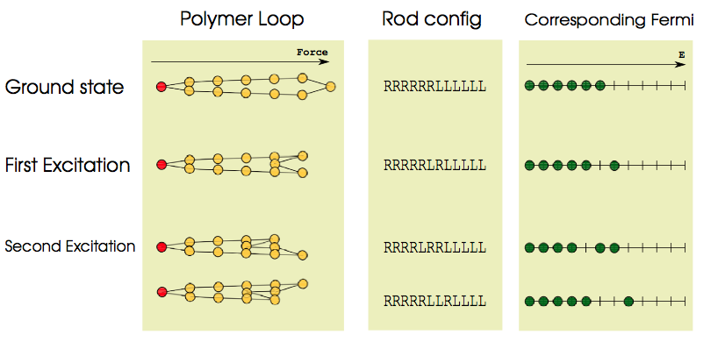
Theory for 1D model
Hamiltonian:
Equivalent to N/2 Fermions in N energy levels

Slide 10
Theory for 1D model
Partition function
By setting natural temperature unit
Fermi-Dirac distribution
Statistical Results

Slide 11
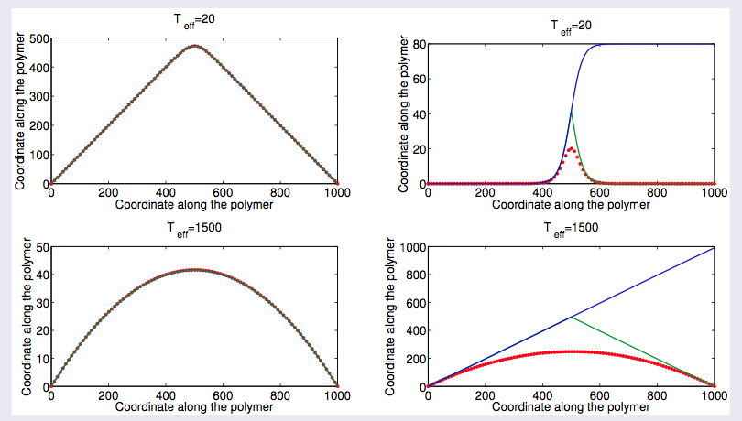
1D Theory

Slide 12
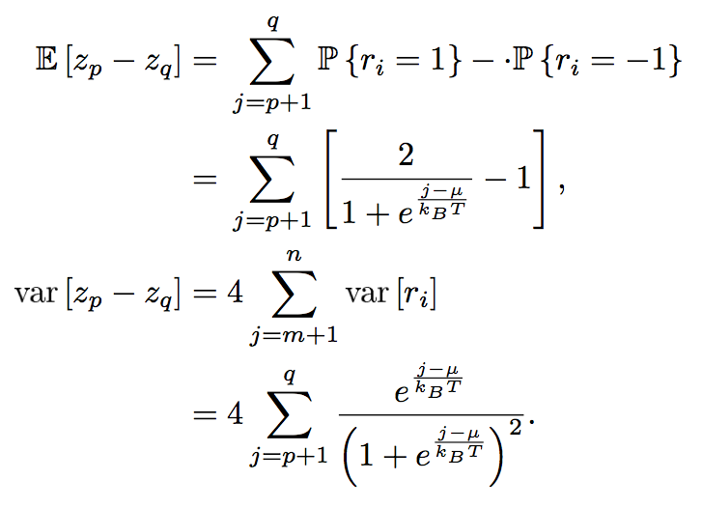
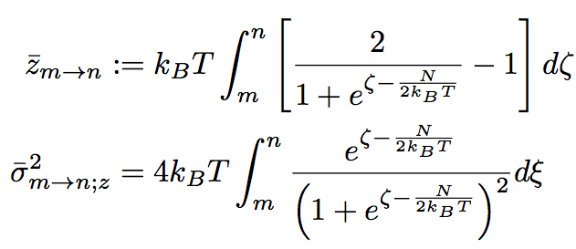
Brownian Bridge Approach
--- devise an effective stochastic process satisfies Z_{N}= Z₀
Step 1: construct effective process:
Z₀ = 0;
Z_{l} is almost surely continuous;
Z_{l} has independent increments;
Where the mean and the variance is determined by:

Slide 13
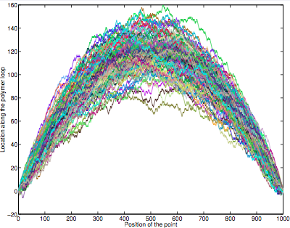
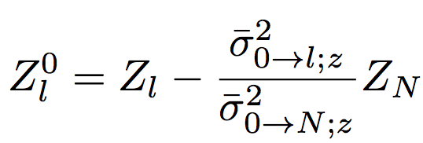
Brownian Bridge Approach
--- devise an effective stochastic process satisfies Z_{N}= Z₀
Step 2: introduce loop condition
Construct conditional process:
where

Slide 14
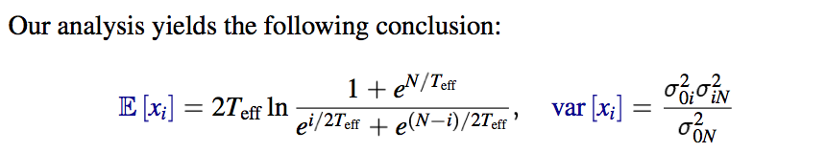
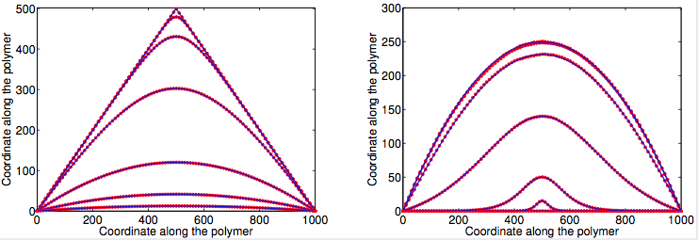
Numerical Verification of 1D model

Slide 15
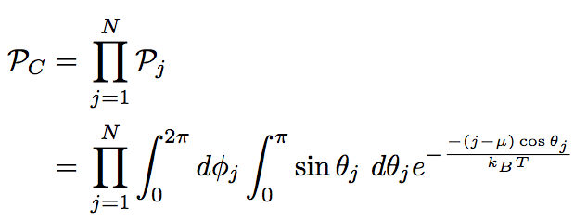
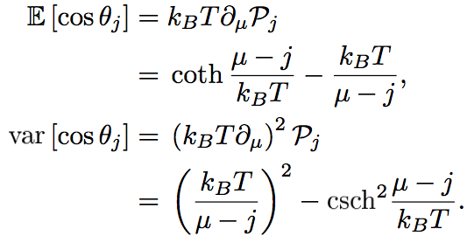
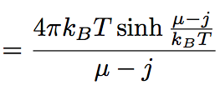
3D Continuous Model
Hamiltonian
Heisenberg model
Partition function

Slide 16
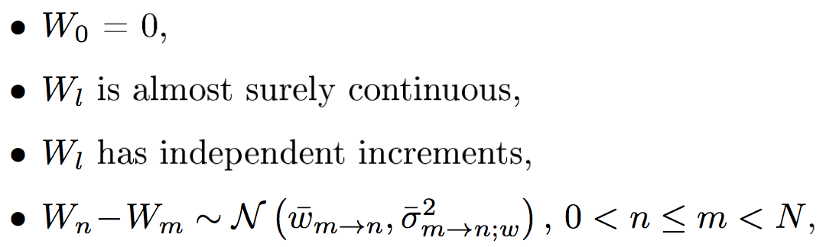
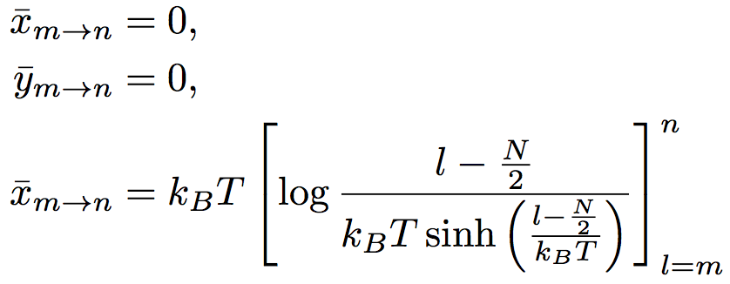
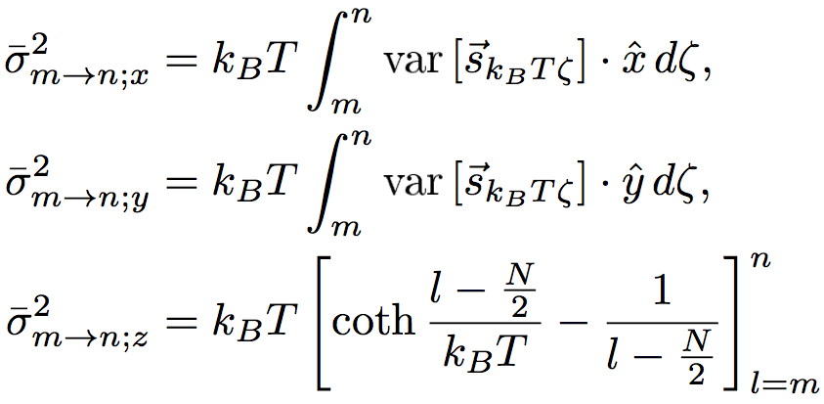
Adopt Brownian Bridge Approach
Define Effective 3D stochastic process:
Conditional effective process:

Slide 17
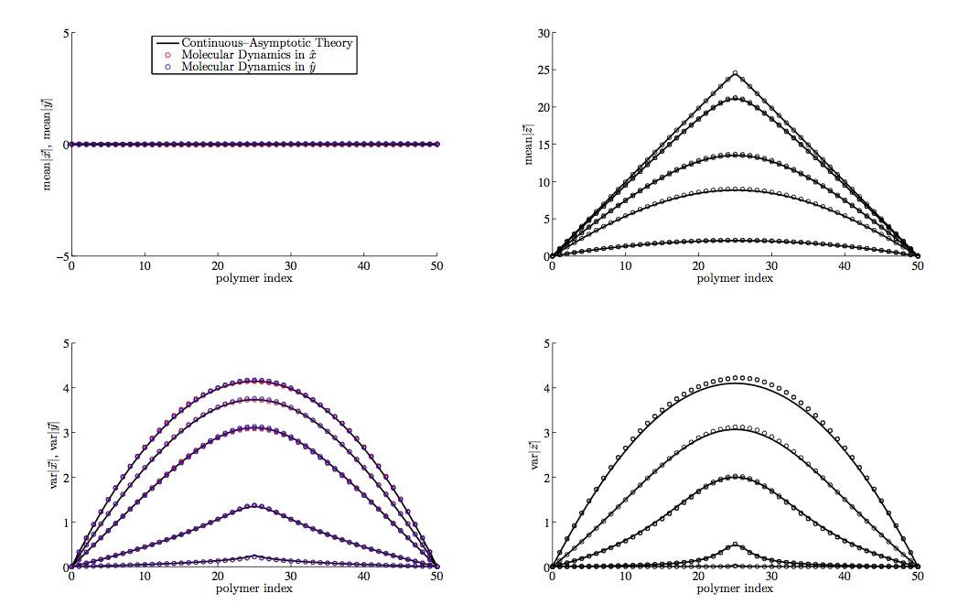
Numerical Verification of 3D model

Slide 18
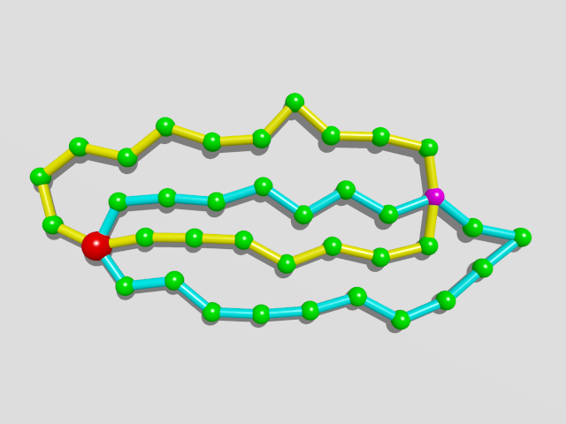
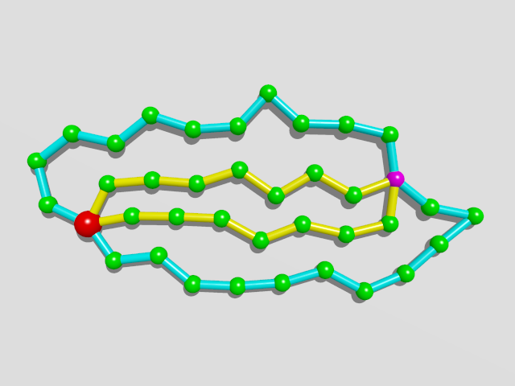
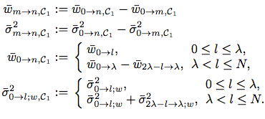
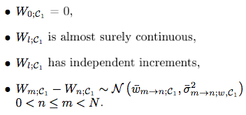
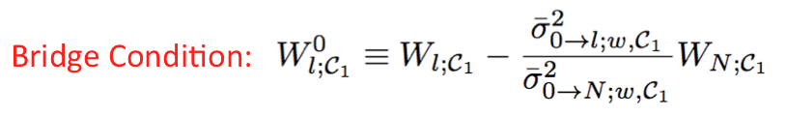
A Pair of Rings with Centromere
Re-label the loops
Brownian Bridge

Slide 19
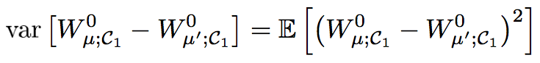
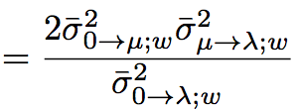
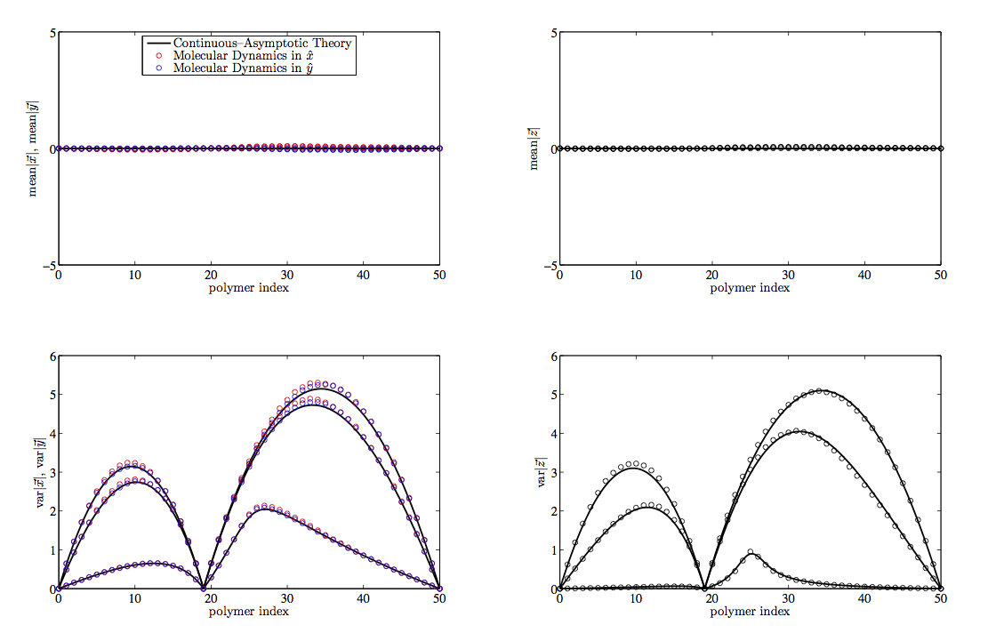
Numerical Verification
Theoretical Result

Slide 20
Outlook & Problems
Include volume exclusion effect?
Non-equilibrium?
(relaxation time/driven by periodic force?)
Heavy computation for real system size.
(parallel computation/GPU technique?)

Slide 21
All suggestions and comments
are greatly appreciated!
Thank you!

Slide 22
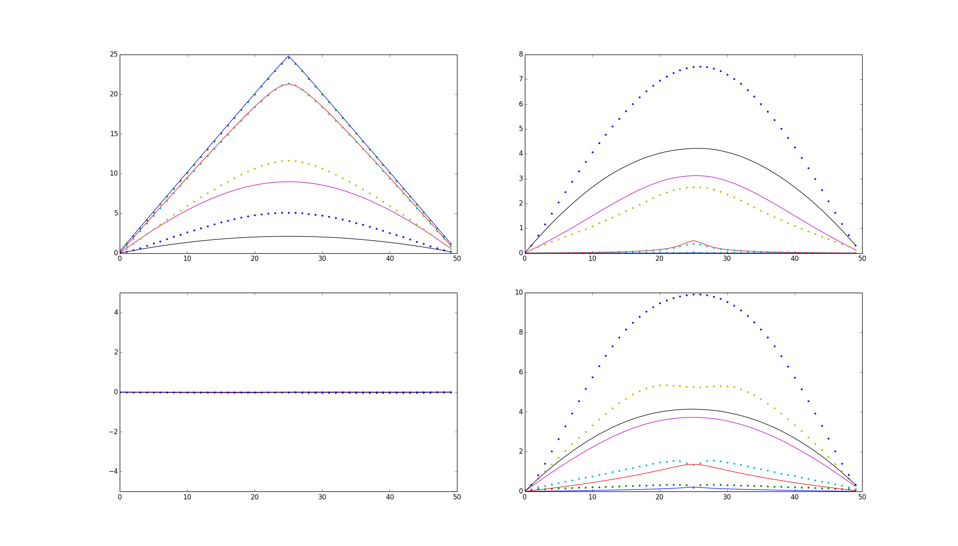
Outlook & Problems
Compare simulation results with & without
Lennard-Jonnes potential

Slide 23
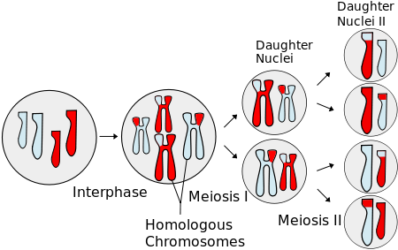
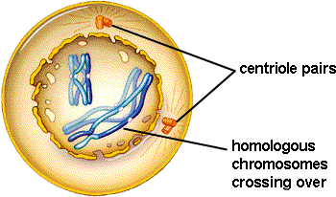
Meiosis
Prophase I
Chromosome movements
Pairing
Recombination

Slide 24
Brownian Dynamics:
Inertia-less assumption
is the index of bead
is hydrodynamic force
represents force generate from potential
is constraint force to keep the rod length
is brownian force
is external force

Slide 25
Brownian Dynamics:
Dynamical differential equation:

Slide 26
Numerical Scheme
Predictor-corrector algorithm:
Step 1: predict using known forces
Step 2: correct using constraint force
(*)
Step 3: substitute eq. (*) to constraint equations
Solve a set of nonlinear algebraic equations
Step 4: re-substitute to (*) obtain the final

Slide 27
Parameter Estimation
Length of Chromosomes in base pairs:
There are 3 pairs of chromosomes in prophase fission yeast
Chromosome I: 5.579.133 bp ~ 5,6Mbp
Chromosome II: 4.539.804 bp ~ 4,5Mbp
Chromosome III: 2.452.833 bp ~ 2,5Mbp
Compaction ratio of chromosomes: ~ 100bp/nm
Kuhn length(rod length): ~ 100nm
System size for 3 pairs of chromosomes: ~ 2000-3000
monomers in one ring : 200 ~ 600

Slide 28
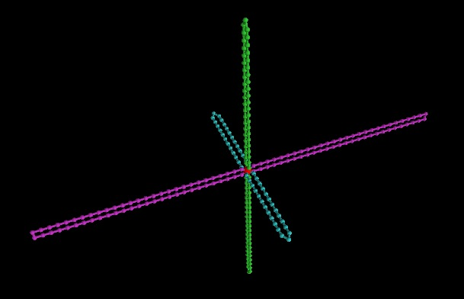
Initial configuration

Slide 29
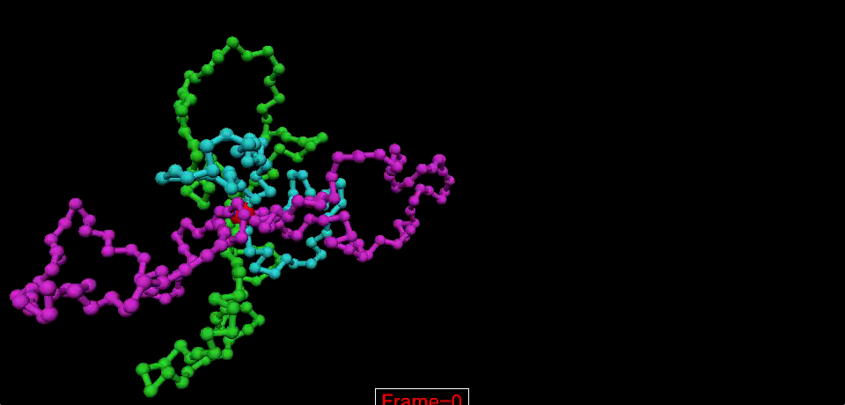
Animation Movie

